Slide 1
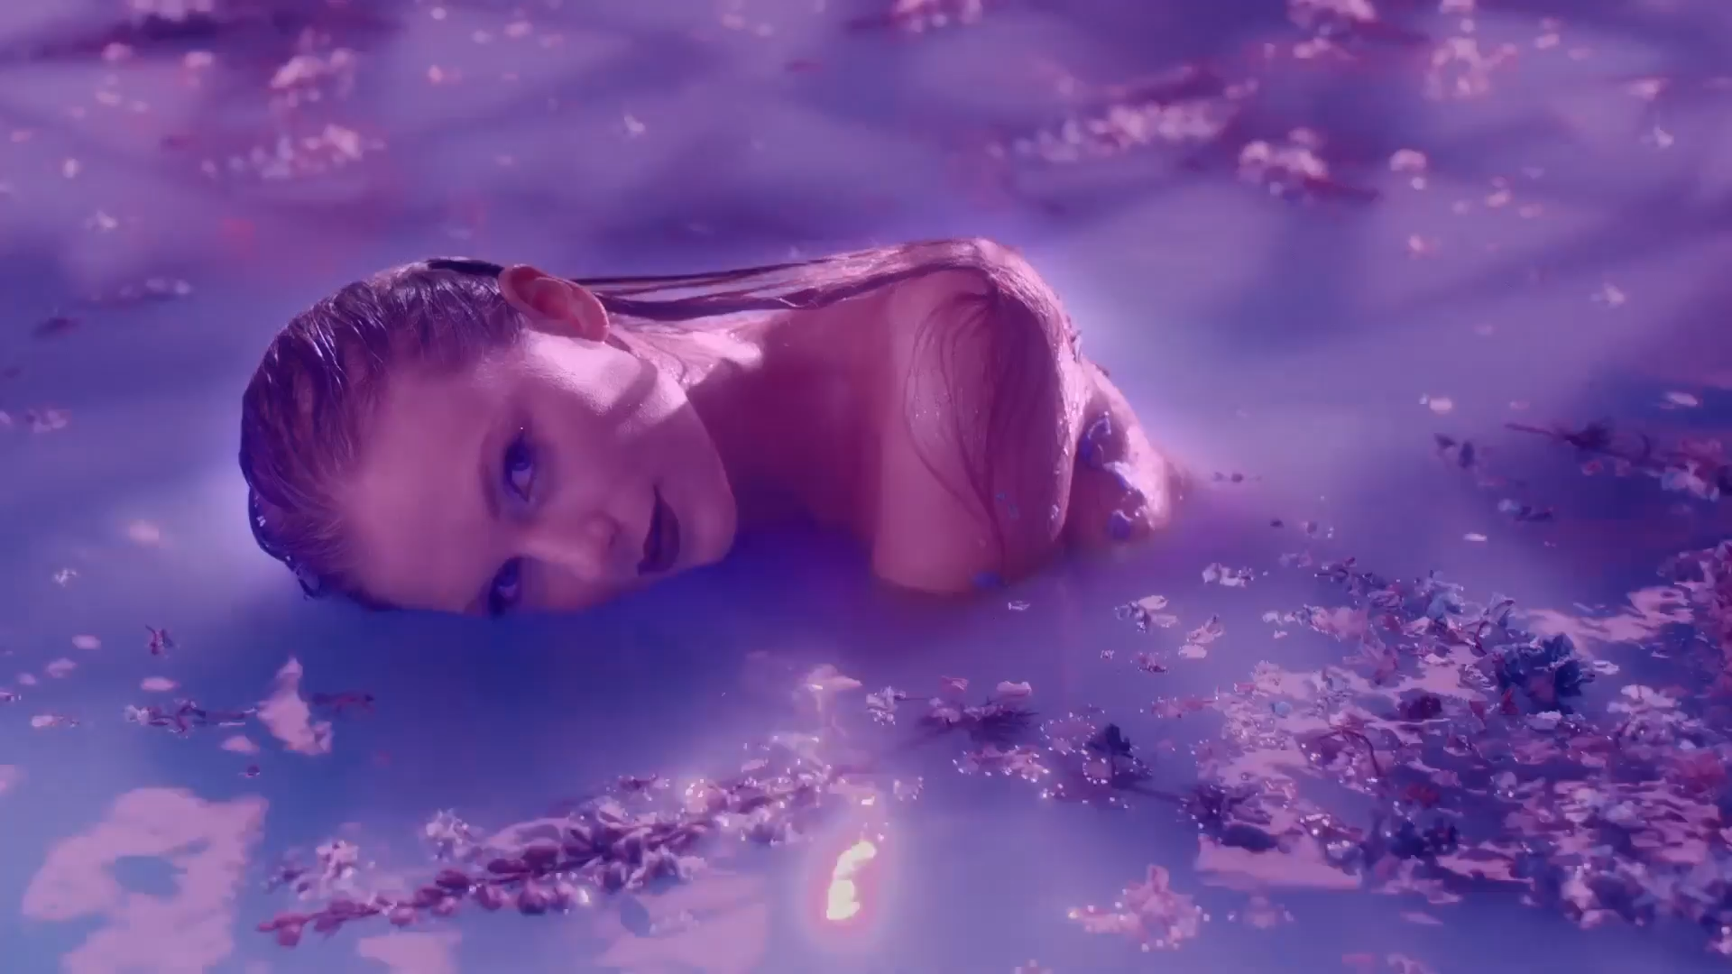
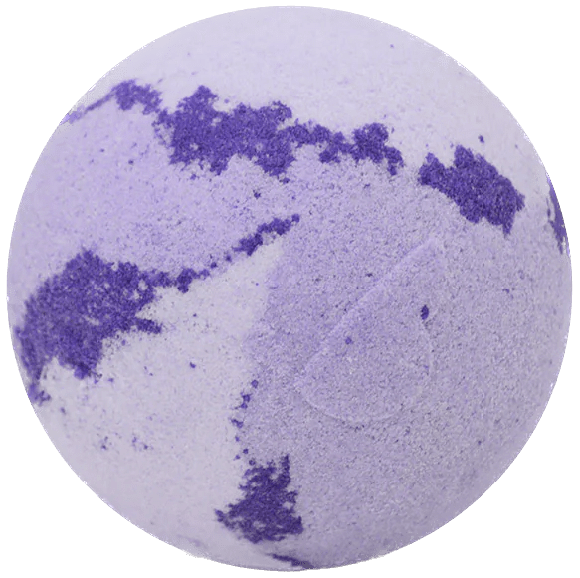
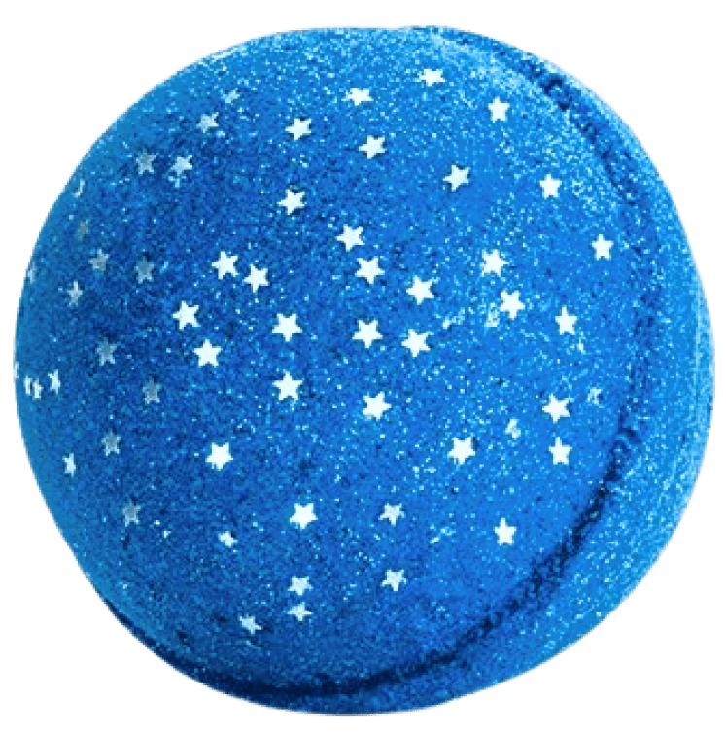
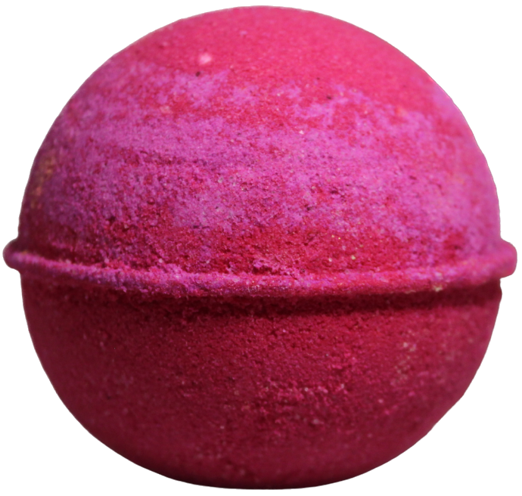
Midnights
Midnights By Taylor Swift
Home
Shop
Cart
Contact Us
By Taylor Swift

Slide 2
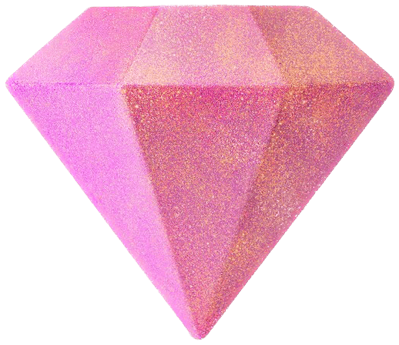
Bath Bombs
Midnights By Taylor Swift
Home
Shop
Cart
Contact Us

Slide 3
Bath Bombs
01
Midnights By Taylor Swift
Home
Shop
Cart
Contact Us
Lavender Haze
Lavender is known to promote calmness and wellness, while reducing stress and anxiety.
Add to cart

Slide 4
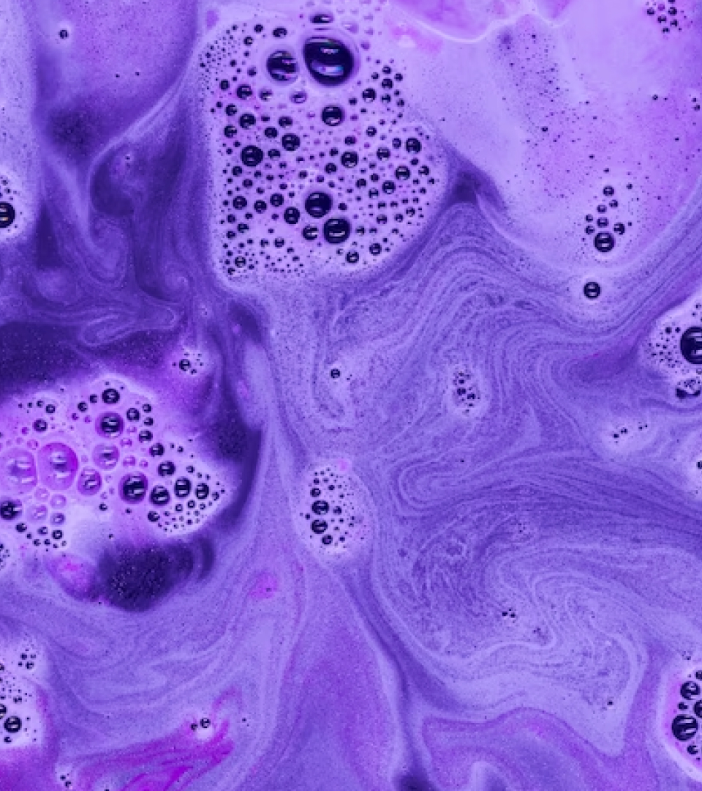
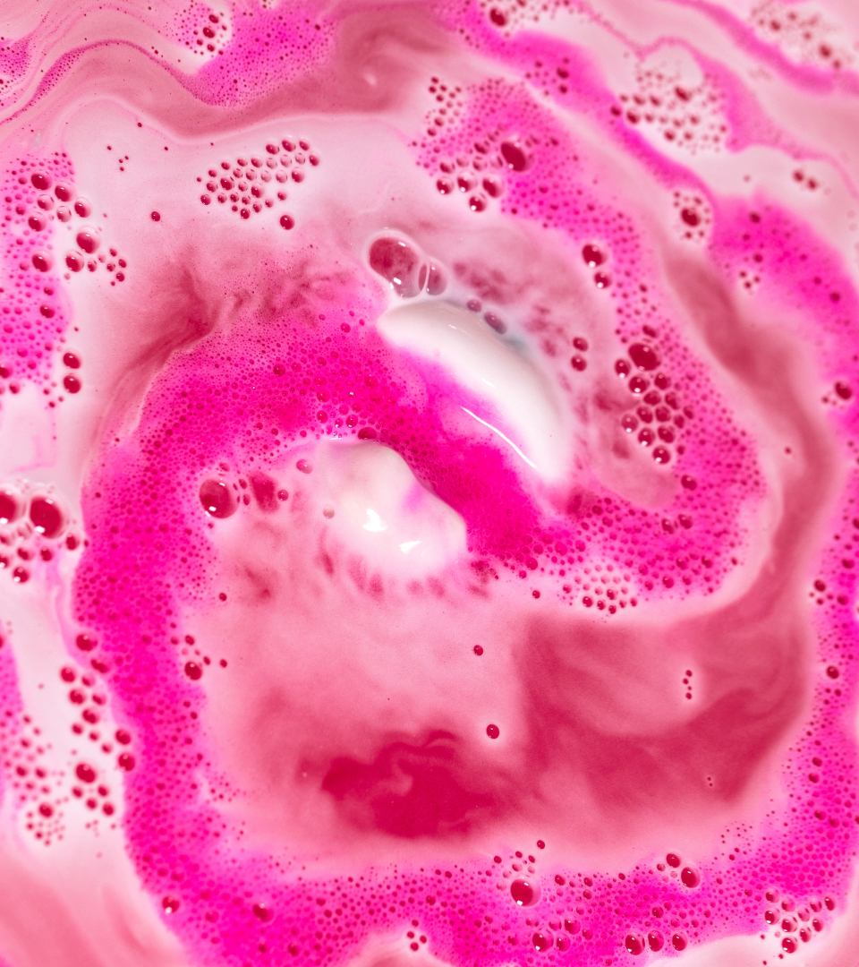
Midnights By Taylor Swift
Home
Shop
Cart
Contact Us
Lavender Haze
Lavender is known to promote calmness and wellness, while reducing stress and anxiety.
Bath Bombs
01
Add to cart
Bejeweled
Adorned with beautiful jewel-toned colours that will transform your bathwater into a stunning work of art.

Slide 5
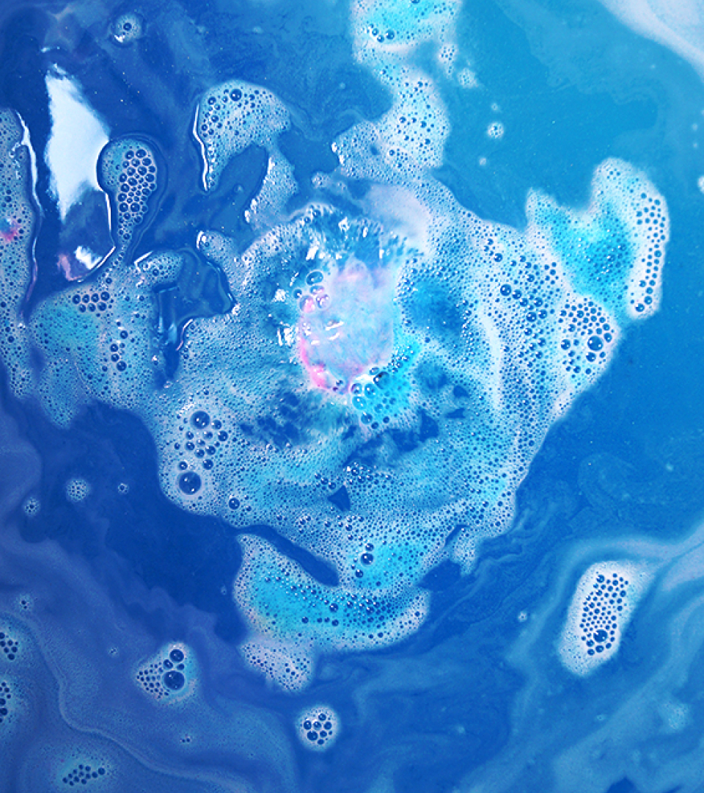
Lavender Haze
Lavender is known to promote calmness and wellness, while reducing stress and anxiety.
Midnights By Taylor Swift
Home
Shop
Cart
Contact Us
Bejeweled
Adorned with beautiful jewel-toned colours that will transform your bathwater into a stunning work of art.
02
Add to cart
Midnight Rain
Let this bath bomb help you find the calm after the storm and wash away the pain.

Slide 6
Bejeweled
Adorned with beautiful jewel-toned colours that will transform your bathwater into a stunning work of art.
Midnights By Taylor Swift
Home
Shop
Cart
Contact Us
Midnight Rain
Let this bath bomb help you find the calm after the storm and wash away the pain.
03
Add to cart

